Slide 1
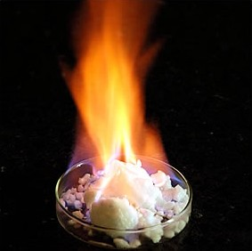
Methane Hydrates
Environmental Science Presentation
Christe Marbbn
March 11th, 2009

Slide 2
Table of Contents
Overview
Factors Required to Form Deposits
Natural Deposits
Reservoir Size
Extraction Techniques (Present, Future Prospects)
How Methane Hydrates can be Harvested into
Energy – Proposed Method
EROI of Methane Hydrates
Issues Surrounding Methane Hydrates
  Environmental
  Technological
  Economical

Slide 3
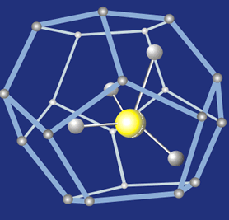
Introduction
Overview
Methane hydrate, also called methane clathrate or methane ice
Methane hydrates and the Solar System
Methane hydrates have been found under sediments on the ocean floors of Earth (Hoffmann, 2006).

Slide 4
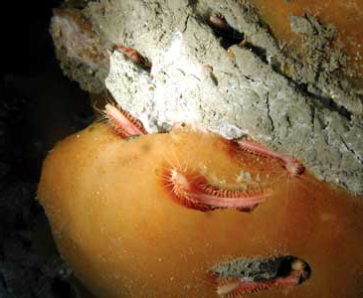
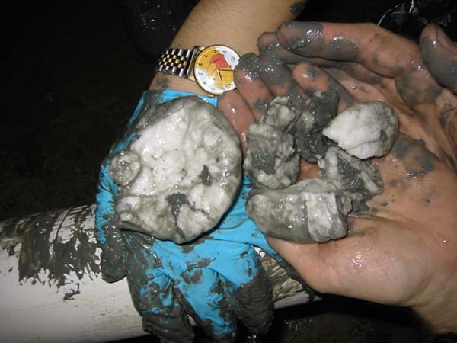
Introduction
Overview (cont.)
Methane hydrates can be found in water bodies or even land masses
They are formed via gas rising and precipitating/crystallization when in contact with cold seat water
Vs.

Slide 5

Introduction
Overview (cont.)
Stability of methane hydrates
Methane hydrate = 1 mole of methane for every 5.75 moles of water
The observed density is around 0.9 g/cm³

Slide 6
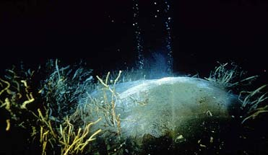
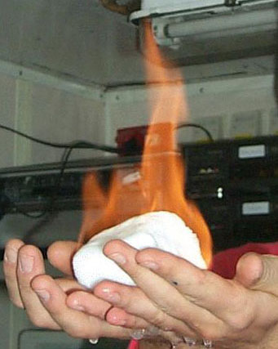

(Above) Methane Hydrates are relatively abundant in sea-floor mounds on the Gulf of Mexico. Here methane is actively dissociating from a hydrate mound.
(Above) Methane hydrate undergoing combustion at room temperature. It looks like pieces of Ice are burning. Interestingly, as it releases heat, water drips.
(Left) A student
carelessly handling a large deposit of methane hydrate crystal.
It is important to note that hydrates can cause an explosive hazard for exploration rigs, production platforms and pipelines, especially in deep water conditions due to these chemical properties.

Slide 7
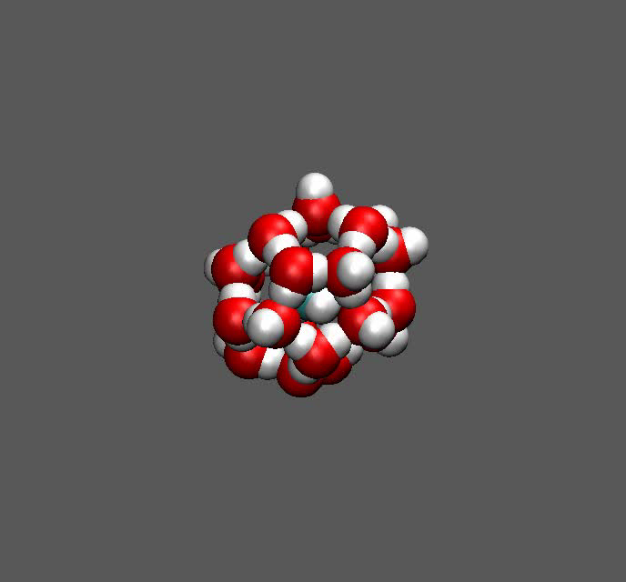
A molecular dynamics simulation illustrating dissociation of methane from its water cage.

Slide 8

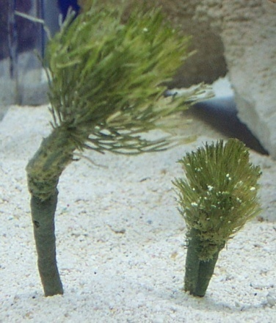
Factors Required to Form Hydrates
First, a gas must be present
Two major sources for gas production:
  Gas is produced thermocatalytically as a result of breakdown of organic carbon to oil and gas
  Gas is produced bacteriologically by relatively shallow decomposition of organic matter
Vs.
Lerche & Bagirov, 2004

Slide 9
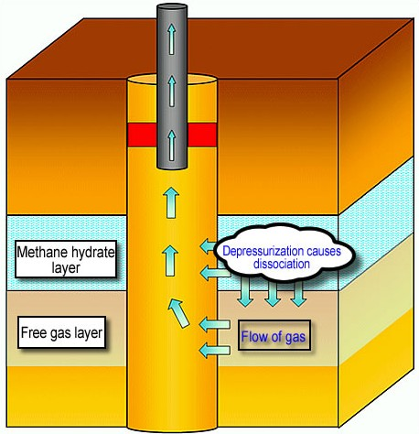
Factors Required to Form Hydrates
Once gas is made it must migrate in order for precipitation to occur
Gases near the surface don’t have
to migrate as much as gasses found
deeper in the ocean
Lerche & Bagirov, 2004

Slide 10
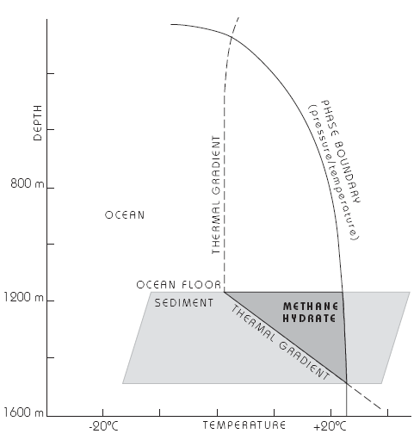
Factors Required to Form Hydrates
Formation conditions of methane hydrates
Teledyne ISCO, 2008

Slide 11
Natural Deposits
Methane hydrates are restricted to the shallow lithosphere (i.e. < 2000 m depth).
Proper conditions?
  are found only either in polar continental sedimentary rocks where surface temperatures are about 0 °C
  oceanic sediment at water depths greater than 300 m where the bottom water temperature is around 2 °C.
Continental deposits have been located in Siberia and Alaska in sandstone and siltstone beds at less than 800 m depth
(Lerche & Bagirov, 2004)

Slide 12
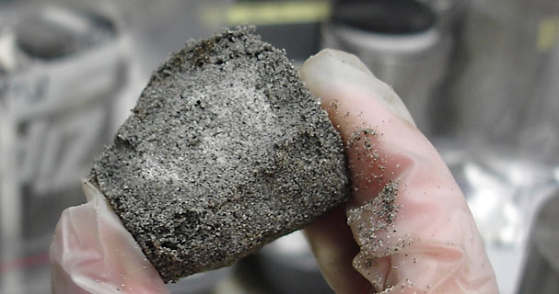
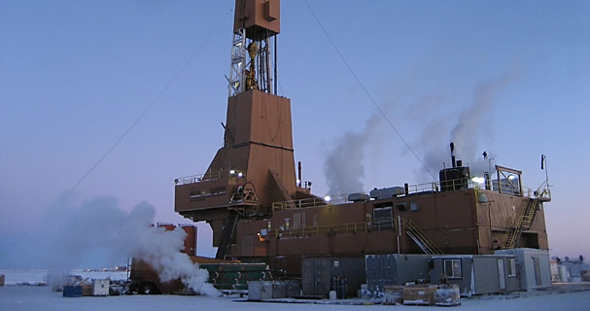
(Above) Methane hydrate-bearing sandstone from a test well dug in Alaska
(Right) This rig is part of a hydrate
Research test on Alaska’s North.

Slide 13
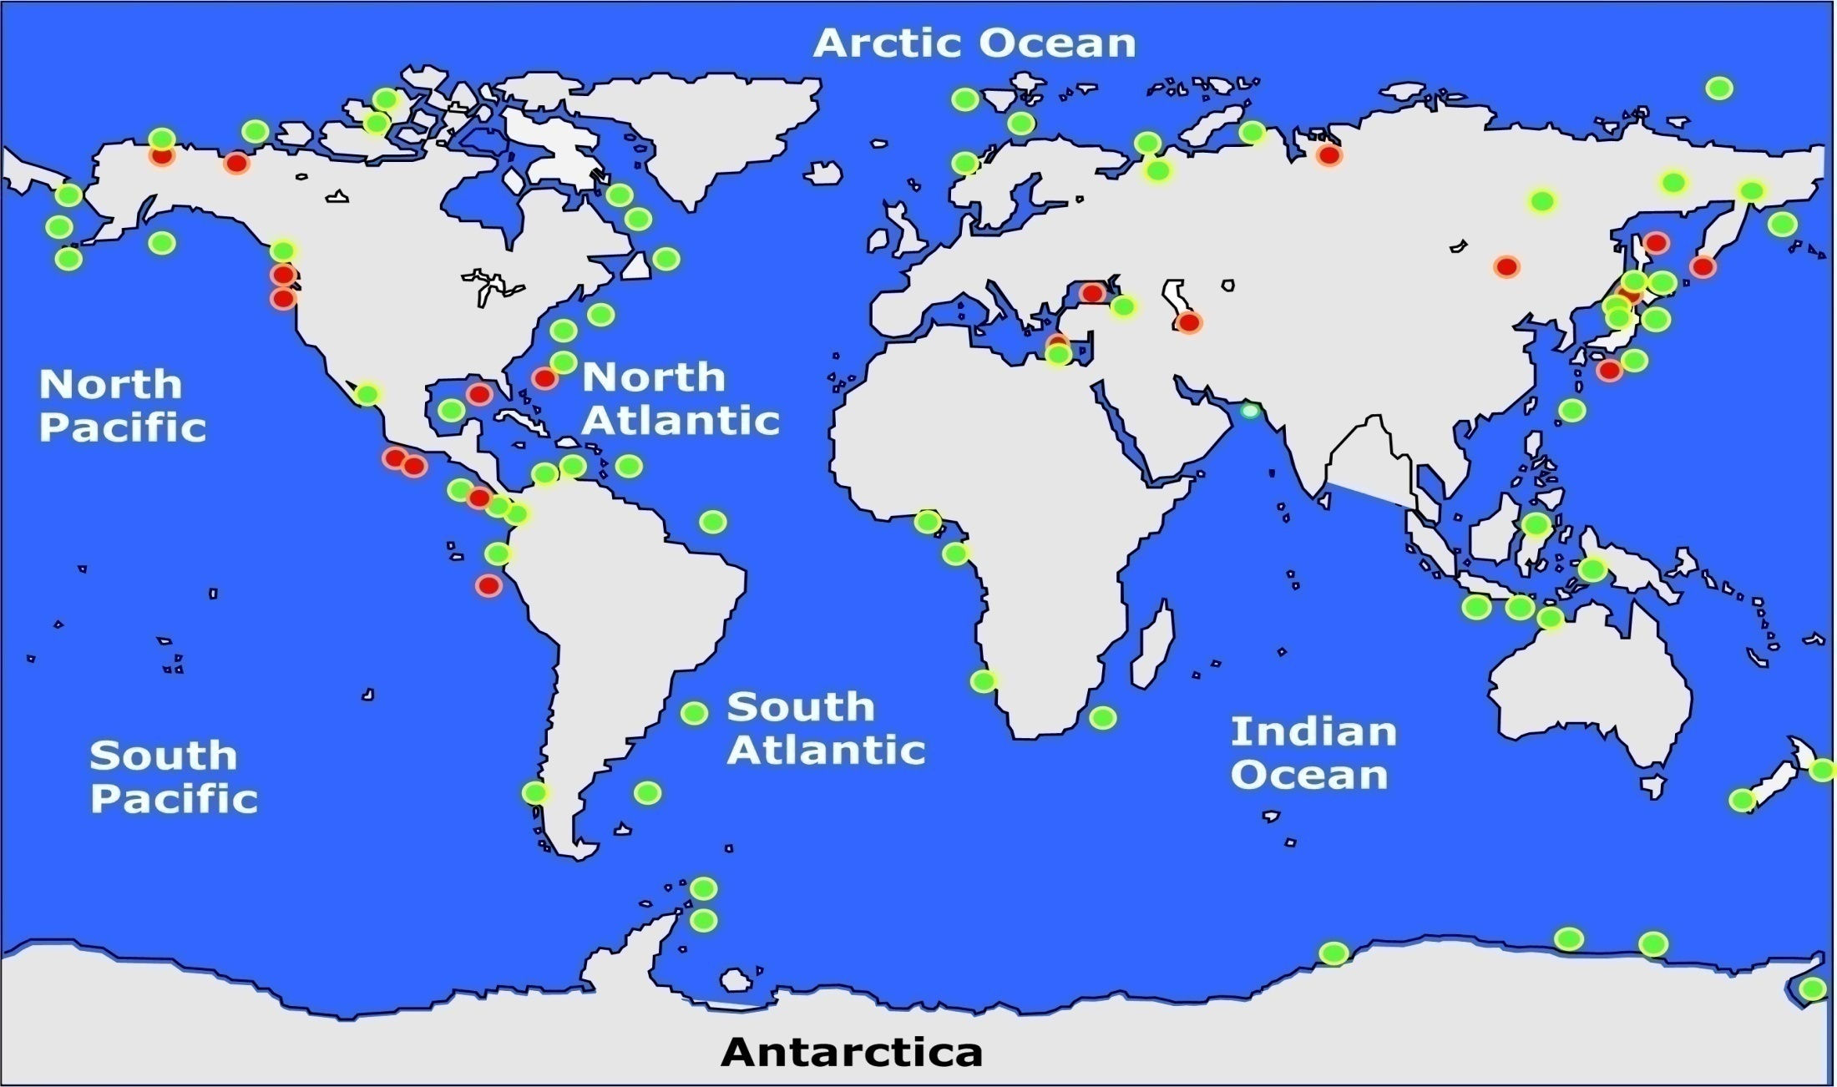
Gas hydrate sample site
Other likely hydrate offshore occurrences
Worldwide distribution of confirmed or inferred offshore gas-hydrate-bearing sediments, 1996.

Slide 14
Types of Methane Hydrate Deposits
Drilling Rig
Frozen Ground Surface
Ocean Deposits, impermeable solid methane hydrate embedded in sediment
500 meters
Arctic Deposits relatively close to surface
Biogenic methane generated in shallow ocean sediment to a depth of 900 meter
Methane hydrate deposits can be 300 to 600 meters thick and cover large horizontal areas
Sediment
perhaps
8 kilometers
deep
Trapped methane gas
Slow seepage of thermogenic methane gas
from below through geological faults

Slide 15
Reservoir Size
Reservoir sizes are poorly known
The highest gobal estimates (e.g. 3×10¹⁸ m³) were based on the assumption that fully dense hydrates would be found on the entire floor of the deep ocean
Recent estimates suggest the global inventory lies between 1×10¹⁵ and 5×10¹⁵ m³ (1 quadrillion to 5 quadrillion).

Slide 16
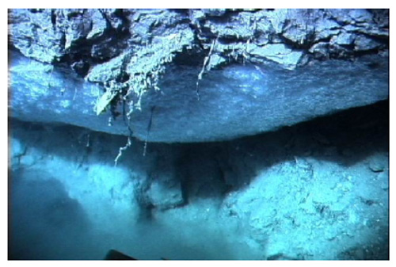
Reservoir Size (cont.)
In the Arctic, permafrost reservoir has been estimated at about 400 Gt C, but no estimates have been made of possible Antarctic reservoirs
For comparison, the total carbon in the atmosphere is around 700 gigatons.

Slide 17
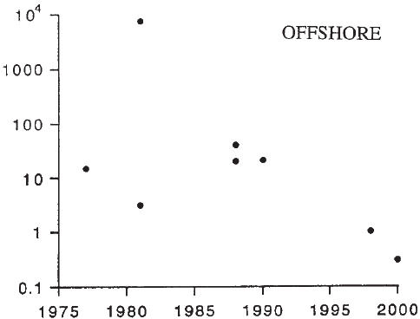
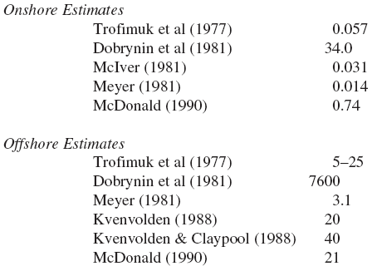
Reservoir Size (cont.)
*Values are measured to 10^15
Estimates of Ginsburg and Soloviev (1998)

Slide 18
Extraction Technique
Ice
Methane Hydrate
Reservoir Bank

Slide 19
Future Technique
1
Overburden pump
Receive pumps
Delivery pump
2
3
Teledyne Isco Pumps: Continuous pumping in constant pressure mode.
Teledyne ISCO, 2008

Slide 20
How Methane Hydrates can be Harvested into Energy
Methane
Hydrate
Slurry
H₂O
Condenser
Sweetening
Unit
Sweet Moist
Gas
Proposed Method

Slide 21

EROI of Methane Hydrates
Their net energy values are low because they are expensive to extract and process
  They have Low Energy Returned on Invested (EROI) ratio of about 3:1
Due to high input required to obtain a negligible yield, there would be little profit earned

Slide 22



Issues Surrounding Methane Hydrates
There are various factors in which one must consider before extracting methane hydrates, namely:
  Environmental
  Technological
  Economical

Slide 23
Environmental Aspects
Global methane hydrate reservoir dynamics may be sensitive to climate change.
  Methane hydrates are potential contributors to the greenhouse effect
  When the methane trapped in the hydrate is released it expands[1]
  Could damage marine ecosystems
Naturally, landslides and tsunamis contribute to the release of large amounts of methane
Likewise, extraction of methane hydrates can release excessive methane

Slide 24
Possibilities of the past
183 million years ago many of the life forms in sea vanished
  It is believed reservoirs of methane trapped in the ocean was released
  This depleted oxygen in the ocean
  Release of methane caused an increase in atmospheric and deep sea temperature
    Warming was called the Latest Paleocene thermal maximum
      A link was found between the warming period and methane release

Slide 25
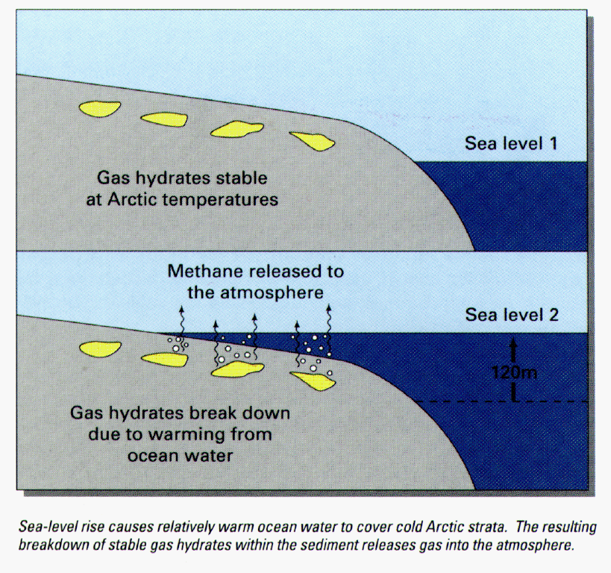
Release of methane hydrates
Dillon, 1992

Slide 26
Technological Aspects
Proper technology has yet to be developed to cleanly extract methane hydrates.
Recently, China became the fourth country after the USA to develop some form of technological device to extract this potential fuel source.
Nations have yet to develop long-term stable technologies to make a profit (Tsukisamu-higashi, 2001).

Slide 27
Economic Aspects
Since methane hydrate reservoirs are not concentrated at a single area, more digs and extractions must take place in order to obtain an adequate amount.
It also costly to undergo research that could develop new technologies.

Slide 28
References
Dillion, W. (1992). Gas Methane Hydrates: A New Frontier. Retrieved from: http://www.aist.go.jp/GSJ/dMG/dMGold/hydrate/usgs/usgs_hydrate.html.
Hoffmann, R. (2006). Old Gas, New Gas, 94, American Scientist, pp. 16–18.
Johnson ,J. (1995). Methane Hydrate Simulations. University of Pittsburgh. Retrieved March 7, 2009, from http://www.puccini.che.pitt.edu.
Lerche, I., & Bagirov, E. (2004). World Estimates of Hydrate Resources, Basic Properties of Hydrates, and Azerbaijan Hydrates. World Estimates of Hydrate Resources, Basic Properties of Hydrates, and Azerbaijan Hydrates. 22, 3-56.
Roach, J.(2003). Paleontological Science Center. Retrieved March 7, 2009, from http://www.lakepowell.net/sciencecenter/catastrophic.htm.
Teledyne ISCO, (2008). Methane Hydrate Studies: Using Teledyne ISCO Syringe Pumps.
Tsukisamu-higashi, S. (2001). Methane Hydrate Research Laboratory. MHL-AIST. Retrieved March 3, 2009, from http://unit.aist.go.jp/mhlabo/index-e.htm.

